Slide 1

Note: The data and information in this document is reflective of a hypothetical situation and client. This document is to be used for KPMG Virtual Internship purposes only.
Sprocket Central Pty Ltd
Data analytics approach
Safirah Almira - [Junior Consultant]

Slide 2
Note: The data and information in this document is reflective of a hypothetical situation and client. This document is to be used for KPMG Virtual Internship purposes only.
Agenda
Introduction
Data Exploration
Model Development
Interpretation

Slide 3
Note: The data and information in this document is reflective of a hypothetical situation and client. This document is to be used for KPMG Virtual Internship purposes only.
Introduction
Project Overview: Customer Segmentation and Characteristics
Task | Description
Data Pre-processing | Reformatting data type, harmonizing the inconsistent and deleting null values on dataset Row consisting null are eliminated as it is not significant Adding meaningful data e.g. profit, age to enrich the dataset analysis
Data Transformation | Data alignment: removing inaccurate data and mismatch customer id between the demographics and address dataset Remove incomplete customer data (missing demographic / address)
Data Exploration | Customer characteristics and behavior (i.e., who is your customer and why does your customer buy)
Model Development | Assign RFM metrics (recency, frequency, monetary) on customer data Develop clustering models using KMeans based on RFM metrics

Slide 4
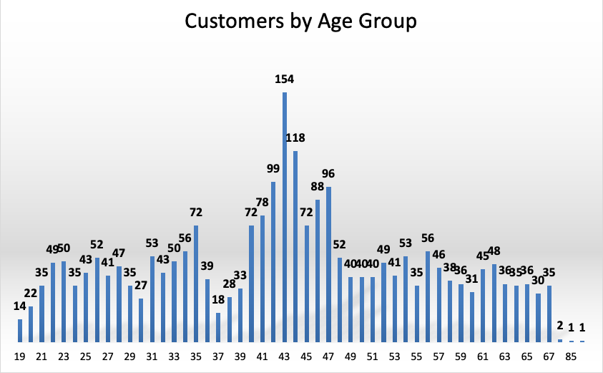
Note: The data and information in this document is reflective of a hypothetical situation and client. This document is to be used for KPMG Virtual Internship purposes only.
Data Exploration
Customers aged 40 - 47 years old are Sprocket Central Pty customers

Slide 5
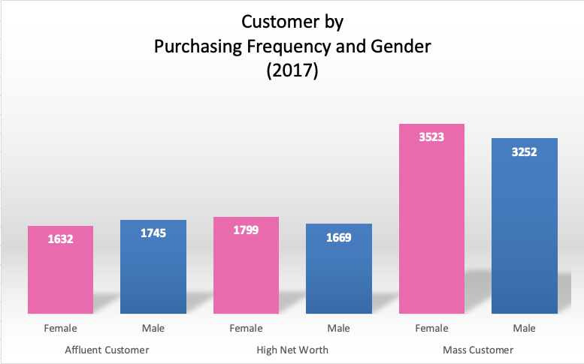
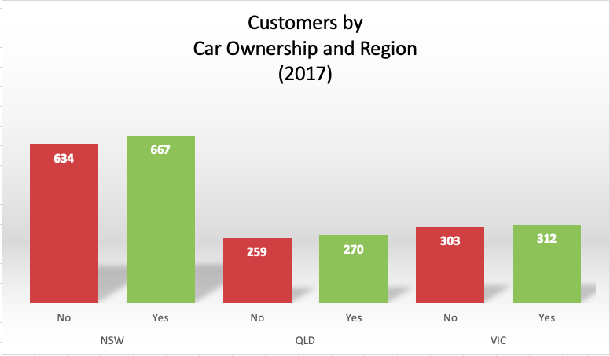
Note: The data and information in this document is reflective of a hypothetical situation and client. This document is to be used for KPMG Virtual Internship purposes only.
Data Exploration
Customer from NSW region has the highest purchase rate. Customers are both car owners and non car owners.
Mass customer significantly occupy bike related purchase with female customer dominating

Slide 6
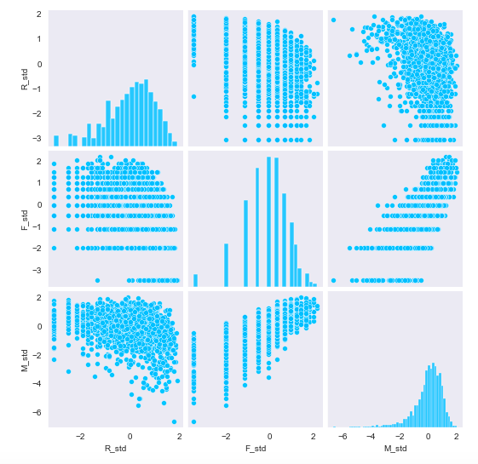
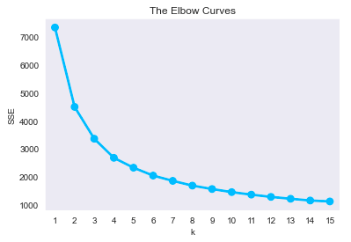
Note: The data and information in this document is reflective of a hypothetical situation and client. This document is to be used for KPMG Virtual Internship purposes only.
Model Development
K-Means analysis through RMF metrics to determine the customer behavior and trends
Objectives | KMeans clustering model to group the customer with similar behavior and psychographics
Details: | Assign RMF metrics to dataset and use scoring for each category. Kmeans start by randomly initialize multiple center points on the dataset. The center points will be train to move towards area with dense population. With this model, it aid in discovering the relationship between each features of the customer. Thus, providing insight on the market segmentation. Elbow curve method is used to determine how many optimize clusters that should be made. Elbow in K = 4, hence 4 clusters. Dataset is normalized using log as it is left skewed.

Slide 7
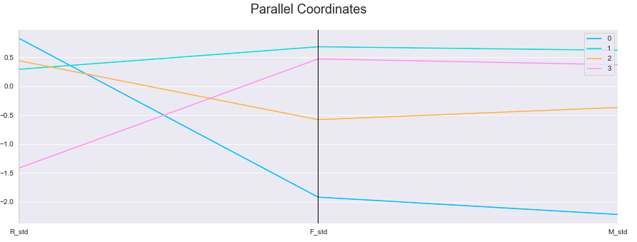
Note: The data and information in this document is reflective of a hypothetical situation and client. This document is to be used for KPMG Virtual Internship purposes only.
Model Development
Assign RMF Metrics to Dataset
R = recency
(customer last purchase)
M = monetary
(profit sum per customer_id)
F = frequency
(transaction_id per customer_id)
Cluster 0 (LOSS) : No longer transacting, low frequency and monetary
Cluster 1 (LOYAL) : Active in transaction, high frequency and monetary
Cluster 2 (CHURN) : Stop transacting after several purchase, low monetary
Cluster 3 (POTENTIAL) : Active, potential frequency and monetary

Slide 8
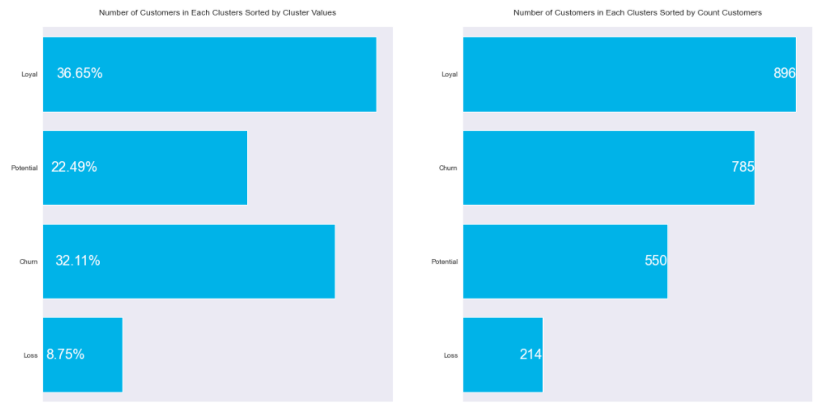
Note: The data and information in this document is reflective of a hypothetical situation and client. This document is to be used for KPMG Virtual Internship purposes only.
Interpretation
Top 1000 are customers who categorized as ‘Loyal’ and ‘Potential’
Example of new customer data output
Loyal Customers = 896
Potential Customers = 104 (rank by highest monetary)

Slide 9
Note: The data and information in this document is reflective of a hypothetical situation and client. This document is to be used for KPMG Virtual Internship purposes only.
Appendix

